Slide 1
RAD Modernization Roadmap Recommendations
OAS Proposal
July 2024

Slide 2


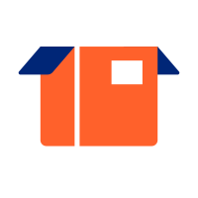


RAD Data Modernization Exec Summary
Prepare the Team
Training Plan Definition
Team Training Execution
Start building the cloud solution
Ops & Maintenance
RAD Team to begin formal training on Cloud Tech Stack w/ goal of being able to hand-on development during build phase. OAS, in parallel, defines & designs the future cloud solution targeting the UHG enterprise standard cloud data tech stacks and solution patterns.
Initial Build, Test, & Deployment
Evolution
Partner w/ OAS on the development and deployment of a cloud data platform providing equivalent reporting & analytic capabilities as currently available on-premises
RAD Team takes full ownership of the ongoing operations of the new cloud data platform solution as well as undertaking future enhancements to the solution by engaging OAS SMEs as needed
Plan the build
Solution Definition & Design
RAD Effort
OAS Effort

Slide 3
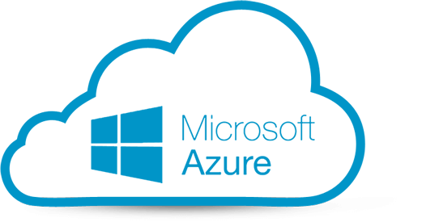

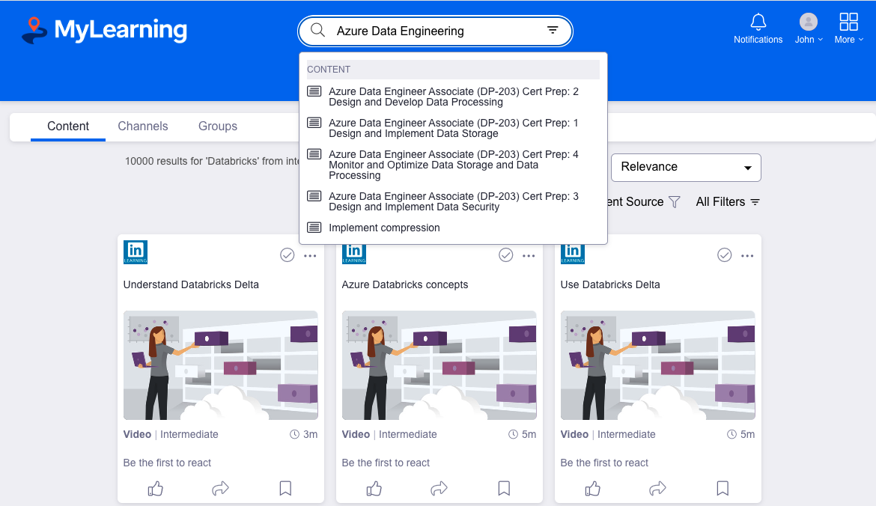


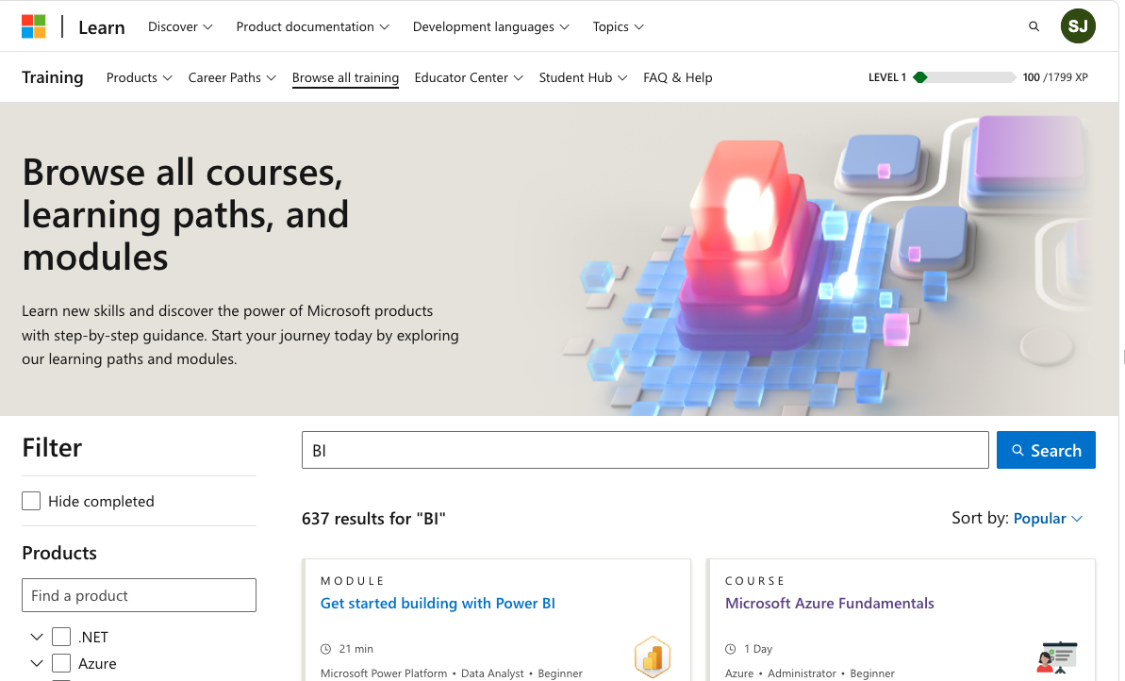


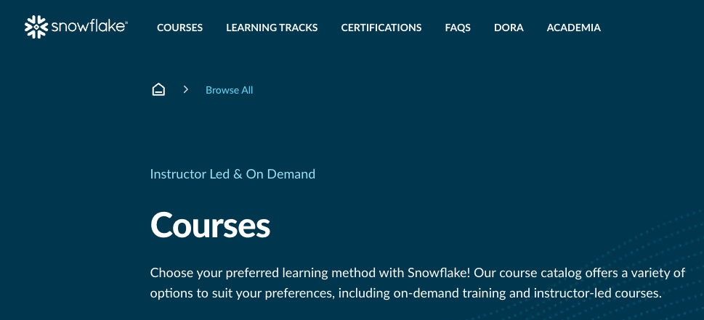
RAD Team Training Opportunities
Microsoft Azure Data Engineering
Open Browser to the Internal UHG Training Site:
https://uhg.edcast.com/
Use the search box on the above site to search for and participate in training options that are available
Key Training Topics
Training Topics Available
Azure Data Engineering
Databricks
Snowflake
Azure Blob Storage
Azure Functions
Azure Logic Apps
Azure Data Fabric
Azure Data Factory
Azure DevOps
PowerShell
Power BI
Databricks Data Engineering
Open Browser to the Microsoft Learning Site & Log-In using your MS ID:
https://learn.microsoft.com/en-us/training/browse/?terms=BI
Use the search box on to search for and participate in training options that are available
Key Training Topics
Training Topics Available
Azure Data Engineering
Databricks
Lakehouse Fundamentals
Data Science & Engineering
SQL Analytics
Databricks Administrator
Snowflake Data Engineering
Open Browser to the Snowflake Learning Site and register:
https://learn.snowflake.com/en/courses/
Look for specific courses or follow Learning Tracks to pursue desired Snowflake training
Key Training Topics
Training Topics Available
Snowflake Data Engineering
Snowflake Administration
SnowPro Certification
Snowflake Data Engineering
Snowflake Administration
SnowPro Certification

Slide 4

RAD Modernization Recommended Roadmap
1
Solution Definition & Design
2
Data Platform Dev, Test, & Deployment
3
PAT & Decommission
Program Management Milestones:
Start Date: August 12, 2024
End Date: October 4, 2024 (8 weeks)
Key Outcomes:
Define cloud solution patterns identifying the cloud tech stack and appropriate usage of each tool
Build out cloud infrastructure to support pilot prototype development
Build pilot prototypes for cloud solution patterns based on tech stack definition
Detailed solution design for data acquisition & data integration to populate Broze, Silver, and Gold data into RAD Data Platform for all data sources
Detailed estimation of effort for Dev, Test, and Deployment phase of program
Program Management Milestones:
Start Date: October 7, 2024
End Date: February 21, 2025 (~20 weeks)
Key Outcomes:
Finalize and implement end-to-end cloud infrastructure components
Develop, test, and deploy cloud solution patterns for data acquisition & data integration to populate Broze, Silver, and Gold data into RAD Data Platform for all data sources
Define & implement the HCP Data Catalog based data consumption model for RAD Data Platform
Automate deployments of infrastructure & code using terraform and CI/CD capabilities in Github
Program Management Milestones:
Start Date: February 24, 2025
End Date: May 16, 2025 (~12 weeks)
Key Outcomes:
Parallel testing and validation of cloud data pipelines to ensure data outcomes are equivalent to current state expectations
Parallel testing of data consumption use cases to ensure continuity compared to current state
Decommission of on-premises solution after complete sign-off of PAT
5 | 6 | 7 | 8 | 9 | 10 | 11 | 12 | 1 | 2 | 3 | 4 | 5
2025
Scope Assessment
Need to obtain RAD subscriptions for Azure Cloud & SDRP before start of Solution Definition & Design
Solution Definition & Design
Data Platform Dev, Test, & Deployment
Parallel Testing
Decom
RAD Modernization Phases
Project Start-up + Environment & Team Mobilization
Production Acceptance Testing
* PAT & Decom to be led by RAD SMEs with OAS support
Decom
Program
Governance
Azure Data Engineering & Snowflake Training
Cloud Migration Governance / Organizational Design / Change Management

Slide 5
RAD Modernization: High-level Implementation Solution Architecture
Design a centralized data repository which acts as a data lake to store data from diverse data sources in its raw format. It ensures high quality, consistency and formatted for transformation, loading and analysis.

Slide 6
Phase 1: Solution Definition & Design Planning Summary
Sprint 0
Sprint 1
Sprint 2
Sprint 3
Sprint 4
Sprint 5
Sprint 6
Sprint 7
Sprint 8
End
8/5/2024
8/12/2024
Leadership Checkpoint after Sprint 2
10/4/2024
Sprint 0:
Initial team ramp up of core team (RAD SMEs & OAS) to work on Migration.
Coordinate with RAD SMEs to get OAS team access to current state solution environments (data sources, Altrix, SQLServer, Reporting, etc)
Work with RAD SMEs to collect the current state code base for analysis.
Dependencies & Assumptions:
RAD will obtain Azure Cloud subscription and SDRP tenant before the start of project
Access to current solution and code base to be provided by RAD to OAS team at the start of the project
RAD will provide available specifications for the existing data processes on the current solution
Data ETL is expected to require complete re-development based on targeted cloud technologies
Bronze & Silver layer data architecture will need to be defined and refined versus current state
Gold Layer data objects and structure will remain consistent with current state
Acquire Subscriptions for Azure Cloud & SDRP
Initial PI Planning (OAS & RAD Leads)
Ongoing PI Planning (OAS & RAD Leads)
Ownership
OAS
Access to current solution & code base
Define Unique Cloud Solution Patterns based on Analysis of Current State Solution
On-going Knowledge Transfer
OAS & RAD
RAD
Specifications for existing data Processes
Analysis of Existing Solution Patterns for Each Data Source
Define Scope of Representative Pilot Prototype
Design & Develop Representative Pilot Prototypes for In-Scope Data Processes
Functional Testing of Pilot Prototype
Design the End-to-end Data Pipeline for Each Data Source
Design the ADF Workflow Management Framework to Control Execution of Future Data Pipelines
Develop Estimate for Next Phase of Program (Dev, Test, & Deploy)
Deploy Cloud Tech Stack For Pilot Prototype
On-going Platform Administration (Snowflake & Azure)

Slide 7
Proposed Staffing, Roles and Responsibilities: Solution Definition & Design Phase
Executive Oversight
High-level Task | Details | Owner
Project Schedule / Logistics | Project plan, discovery meetings, weekly status meetings, governance meetings, major checkpoint sessions etc. | OAS + RAD
Environment Readiness & Onboarding | Ensure environments are setup for OAS work; on-boarding logistics support for OAS resources | RAD
Infrastructure Configuration and Setup | Perform on-going configuration and administrative setup of Snowflake and Azure Cloud subscription to enable the development and implementation of the NEW cloud-native solution | OAS w/ support from RAD SMEs
Access to Current Solution & Code Base / Specifications | Ensure OAS resources are given access to the current solution and existing code base to be able to perform analysis to translate to a cloud-native solution | RAD
Define Unique Cloud Solution Patterns based on Analysis of Current State Solution | Analyze the current state solution to identify unique solution patterns that need to be defined based on the new cloud tech stack involving Azure Cloud and SDRP/Snowflake. Define the cloud solution pattern including the cloud tools & capabilities to be used to implement various components of the cloud solution pattern. | OAS w/ support from RAD SMEs
Design, Develop, & Test Pilot Prototypes for In-Scope Data Processes | Identify the scope of the pilot prototypes and perform the end-to-end design, development, and testing of the cloud-based solution patterns implementing the pilot prototype solution. | OAS w/ support from RAD SMEs
Design the ADF Workflow Management Framework to Control Execution of Future Data Pipelines | Design and prototype the framework using ADF to provide workflow management functionality that is consistent with capabilities and features currently enabled for RAD along with applicable best practice features. | OAS w/ support from RAD SMEs
Develop Estimate for Next Phase of Program (Dev, Test, & Deploy) | Based on the outcomes of the Solution Definition and Design effort from this phase of the program, perform a detailed estimation of the overall effort involved in the next phase of the program – “Data Platform Dev, Test & Deployment” | OAS w/ support from RAD SMEs
Transition of knowledge to MRIS SME’s | Transition of knowledge to MRIS SME’s | OAS + RAD
Review and signoff | Review and signoff of respective artifacts, deliverables at appropriate phases | RAD
Alex Schmidt Client Executive
Dinesh Malhotra
Executive Oversight
OAS Team
John Shin (Delivery Oversight - US)
TBD (Solution & Design Lead)
For Solution Definition & Design phase, OAS will do the heavy lifting.
There maybe opportunity to leverage RAD resources for next phase if they can be freed from current roles…
TBD (Scrum Master- India)
TBD (Platform Admin - US)
TBD (Pilot Prototype Engineer – India)
TBD (Solution Design Engineer – India)
TBD (Solution Design Engineer – India)
RAD SMEs / Other Contributors
Patrick Whitmer (RAD Data Engineering Owner)
Grant D Haugan
(RAD Data Engineering Lead)
Jason Gehlen
(RAD Data Analytics Owner)
OAS & RAD SMEs Support
(As needed)
Key:
RAD
OAS

Slide 8

Program Commercials Summary
Program Phase | Start Date | End Data | Duration in Weeks | Cost Type | Paid To | Projected Costs
Scope Assessment | 6/17/2024 | 7/12/2024 | 4 | Labor | OAS | $12,000 (Fixed)
Solution Definition & Design | 8/12/2024 | 10/4/2024 | 8 | Labor | OAS | ~$192,000 (T&M)
 |  |  |  | Cloud Infra (Azure Cloud & SDRP) | OptumTech | ~1,500 per month
Data Platform Dev, Test, & Deployment | 10/7/2024 | 2/21/2025 | 20 | Labor | OAS | ~$480,000 (T&M)
 |  |  |  | Cloud Infra (Azure Cloud & SDRP) | OptumTech | ~1,500 per month
Production Acceptance Testing | 2/24/2025 | 4/18/2025 | 8 | Labor | OAS | ~$74,000 (T&M)
 |  |  |  | Cloud Infra (Azure Cloud & SDRP) | OptumTech | ~3,000 per month
Decommission of Current Solution | 4/21/2025 | 5/16/2025 | 4 | Labor | RAD | Owned by RAD
 |  |  |  | Cloud Infra (Azure Cloud & SDRP) | OptumTech | ~3,000 per month + ~10% annual growth
NOTE:
“Data Platform Dev, Test, & Deployment” phase estimate will be re-estimated as outcome of “Solution Definition & Design” phase
Infrastructure cost for Azure Cloud and SDRP will be direct chargeback from Optum Tech
Future infrastructure cost forecast for Azure Cloud & SDRP will be estimated as part of “Solution Definition & Design” phase

Slide 9
Q&A
Duration of segment

Slide 10
Appendix
Additional details for reference

Slide 11
Inventory of data sources
Data Sources for RAD Data Services
Source System | Daily | Weekly | Monthly | Quarterly | Yearly | Data Acquisition Pattern |  |  |  |  | Grand Total
 |  |  |  |  |  | Flat File | Rest API | SQL/ Oracle | Smartsheet | ECG
Adobe Sign |  | X |  |  |  | 1 | 0 | 0 | 0 | 0 | 1
Ariba |  |  | X |  |  | 2 | 0 | 0 | 0 | 0 | 2
CBRE |  |  | X |  |  | 3 | 0 | 0 | 0 | 0 | 3
Concur |  |  | X |  |  | 0 | 0 | 1 | 0 | 0 | 1
Cority | X |  |  |  |  | 0 | 0 | 1 | 0 | 0 | 1
eGRC | X |  | X |  |  | 4 | 0 | 0 | 0 | 0 | 4
ESG |  |  |  | X | X | 20 | 0 | 0 | 0 | 0 | 20
Field Glass |  | X |  |  |  | 0 | 4 | 0 | 0 | 0 | 4
Hire Right | X |  |  |  |  | 1 | 0 | 0 | 0 | 0 | 1
HR/PeopleSoft/AP | X |  | X |  |  | 3 | 0 | 2 | 0 | 0 | 5
Hubstar |  | X |  |  |  | 1 | 0 | 0 | 0 | 0 | 1
IT Reseller |  |  | X |  |  | 0 | 0 | 0 | 0 | 1 | 1
Lenel | X |  |  |  |  | 0 | 0 | 1 | 0 | 0 | 1
M&A | X | X |  |  |  | 0 | 0 | 1 | 1 | 0 | 2
Mercury | X |  |  |  |  | 0 | 32 | 0 | 0 | 0 | 32
Noosh | ? | ? | ? | ? | ? | 1 | 0 | 0 | 0 | 0 | 1
One-Click | X |  |  |  |  | 0 | 0 | 1 | 0 | 0 | 1
Oracle Cloud | ? | ? | ? | ? | ? | 0 | 1 | 0 | 0 | 0 | 1
OT Datahub |  |  | X |  |  | 0 | 2 | 0 | 0 | 0 | 2
SESH | X |  |  |  |  | 0 | 1 | 0 | 0 | 0 | 1
Grand Total |  |  |  |  |  | 36 | 40 | 7 | 1 | 1 | 85

Slide 12
Inventory of data migration objects (SQLServer)
Data Objects for Migration from SQLServer
SQLServer DB | Bronze Layer |  | Silver Layer |  | Gold Layer |  | N/A - TBD |  | NULL - TBD |  | Grand Total
 | Table Cnt | Size in MB | Table Cnt | Size in MB | Table Cnt | Size in MB | Table Cnt | Size in MB | Table Cnt | Size in MB | Table Cnt | Size in GB
CorpSvcs_EOHS | 30 | 6,080.11 |  |  |  |  | 7 | 1,681.84 |  |  | 37 | 7.6
CorpSvcs_RES | 1 | 22.32 | 11 | 41,689.93 | 8 | 61,392.37 | 115 | 5,266.34 | 1 | 13.88 | 136 | 105.8
ESP_Spend | 57 | 43,627.28 | 7 | 38,278.96 | 14 | 58,324.3 | 19 | 8,719.93 | 206 | 6,592.4 | 303 | 151.9
RES Archive |  |  |  |  |  |  |  |  | 11 | 98121.56 | 11 | 95.8
Grand Total | 88 | 49,729.71 | 18 | 79,968.89 | 22 | 119,716.67 | 141 | 15,668.11 | 218 | 104,727.84 | 487 | 361.1

Slide 13
RAD Modernization: High-level Implementation Solution Architecture
Design a centralized data repository which acts as a data lake to store data from diverse data sources in its raw format. It ensures high quality, consistency and formatted for transformation, loading and analysis.

Slide 15
Future State Slides

Slide 16
API Data Sources Architecture
Data Sources
RAD Azure Subscription
RAD Data Store
HCP Data Catalog
Mercury
Bronze Layer
Silver Layer
Gold Layer
HCP Metadata
HCP Data Products
Azure Logic Apps
Azure Databricks
Table 1
Table 1
Table 1
Table 2
Table 2
Table 2
Gold Layer Metadata
Data Product 1
Data Source 1
API
Table 3
Table 3
Table 3
Data Product 2
Azure Blob Storage
Azure Data Factory
Table 4
Table 4
Table 4
Data Source n
Silver Layer Metadata
Data Product 3
Azure Active Directory
Azure Key Vault
Batch Load VW
ETL Process VW
Dedicated
VW
Data Product 4
UHG Access Security
Compute Tenant
End-User Group 1
Snowflake Auto Failover
RAD Consumption Use Cases
Active Directory
SECURE
Subscribed Data Products
Ad-hoc Query VW
Ad-hoc Query
Compute Tenant DB
Report & BI VW
Reports & BI
Compute Tenant
End-User Group 2
Subscribed Data Products
Ad-hoc Query VW
Data Science
Compute Tenant DB
Report & BI VW

